Slide 1

SQL
Basics fundamentals of sql

Slide 2
AGENDA

Slide 3
AGENDA
MySQL Introduction
Install MySQL on Windows10
MySQL WorkBench
Create Database in MySQL
Create Table in MySQL
Insert Records in a Table
SELECT statement in MySQL
MySQL NOT NULL Constraint
MySQL UNIQUE Constraint
MySQL PRIMARY KEY Constraint
MySQL Check Constraint
MySQL DEFAULT Constraint
MySQL INDEX Constraint
Alter Table in MySQL
Alter Table and add new column
Alter Table and drop column
Alter Table and Modify column
SELECT Distinct in MySQL
Display Records from Specific Column
MySQL WHERE Clause
AND Operator in MySQL
OR Operator in MySQL

Slide 4
AGENDA
NOT Operator in MySQL
MySQL IN Operator
MySQL LIKE Operator
MySQL BETWEEN Operator
MYSQL Comments
MySQL COUNT() method
Alias in MySQL
Case Statement in MySQL
MySQL DELETE Statement
MySQL UPDATE Statement
Drop Table in MySQL
Drop a database in MySQL
MySQL AVG() method
MySQL SUM() method
MySQL MAX() method
MySQL MIN() method
Order Records (Descending Order)
Order Records in MySQL
MySQL Auto Increment
MySQL LIMIT Clause
MySQL Indexes
MySQL Joins

Slide 5

INTRODUCTION

Slide 6
WHAT IS MySQL?
Most Powerful RDBMS – based on SQL
Swidesh company MySQL AB -->Sun Microsystems->Oracle. Now supported and managed by Oracle Corporation.
Used by: Facebook, YouTube, Flicker etc
Written in C and C++
Initial Release: 23 May 1995
Latest version 8.0.40

Slide 7
MySQL WorkBench
User Interface for MySQL i.e., graphical tool for working with MySQL Servers and databases.
Supports MySQL server versions 5.6 and higher

Slide 8
MySQL FEATURES
Based on SQL
Open Source
Friendly and Compatible with PHP. Connect easily and manipulate databases.
Based on Client-Server Architecture.
Secure and Highly Felxible.
Scalable: Support large databases :
1. 50 Millions rows or more in a table.
2. Default file size limit for a table is 4GB(can be increased).
Compatible with major Operating System and languages.

Slide 9
Example
Rows
Database
Table
Database
employee
EmpID | FirstName | LastName | EmpAge | EmpZone
1 | Devanshika | Piparsania | 27 | Bangalore
2 | Anuj | Bokhare | 25 | Bangalore
3 | Shubham | Parashar | 30 | Jaipur
4 | Bhawana | Arora | 34 | Remote
Tables
Rows
Columns
Columns

Slide 10
EXAMPLE
DESCRIPTION:
MySQL has databases which has all the tables and record.
Database has Tables
Every table has Rows in it.
Rows has Columns
That means we have record here. So, Database can have more than 1 table in it
So, let say we have data base employee record, under that we have a table employee, under that we have records, i.e., rows and column.

Slide 11
INSTALL MySQL on Windows10

Slide 12
Steps to download MySQL
Go to this link :MySQL :: MySQL Community Downloads
Click on : MySQL Installer for Windows
Click on Download for this :
Click on : No thanks, just start my download
Open the downloaded file
Select Custom Radio Button and click on next
Select Products : Lastest MySQL Server, Latest MySQLWorkbench, Latest MySQL Shell version
Click on Next >>Click on Execute >>Click on Next >>Click on Execute >>Click on Next >>click o next >>Click on Next>>Create Root Password >>Next>>Next>>Execute>>Finish>>Next>>Finish
Windows (x86, 32-bit), MSI Installer | 8.0.39 | 303.6M

Slide 13
MySQL WorkBench

Slide 14
Steps
Open MySQL WorkBench
Connect with root user by entering password
Lets open Command Prompt
Reached the path where we install MySQL and Copy the path: C:\Program Files\MySQL\MySQL Server 8.0\bin
On command prompt enter – cd and paste the path, press enter
Now, type the command mysql -u root –p
Enter Password, enter
Now, enter command, show databases;, enter
The default database will get visible

Slide 15
CREATE DATABASE IN MySQL

Slide 16
Steps to create database
Open MySQL Workbench
Connect to root user
Click on Schemas tab
Now, right click and select Create Schema
Give name of your database (In Lower case)
Keep things in default and apply
Command to create new Schema is visible : CREATE SCHEMA 'devanshikadb1';
Click on Apply
Click on Finish

Slide 17
Create database through command prompt
open Command Prompt
Reached the path where we install MySQL and Copy the path: C:\Program Files\MySQL\MySQL Server 8.0\bin
On command prompt enter – cd and paste the path, press enter
Now, type the command mysql -u root –p
Enter Password, enter
Now, enter command, show databases;, enter
The default database will get visible
Enter-> create database devanshikadb;
Press-enter(So this create database)
Now, check again with show database command
Enter- use devabshikadb;
Press- Enter

Slide 18
CREATE TABLES IN MySQL

Slide 19
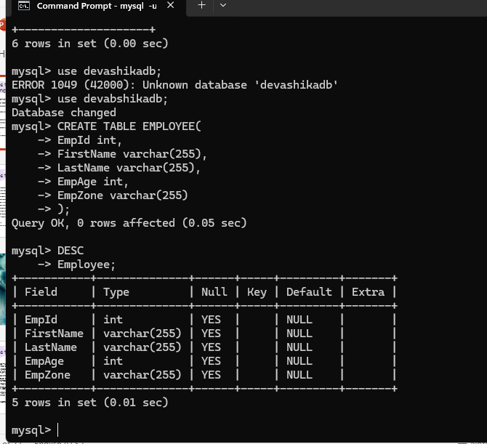
Steps to create table through command prompt
Precondition : Follow all the steps from - "Create database through command prompt".
Resume from -
Enter- use devabshikadb;
Press- Enter
Enter command- CREATE TABLE EMPLOYEE(
Press- Enter
EmpID int,
FirstName varchar(255),
LastName varchar(255),
EmpAge int,
EmpZone varchar(255)
);
Press – Enter
Enter – DESC Employee;

Slide 20
Steps to create Tables
On the database – devanshikadb1, there is tables
Right click on Tables and click on create table
Give table name – Example: employee
Create Columns – By giving column name, datatype, and chosing the key type
And click on Apply
Table will get created: Querry – CREATE TABLE 'devanshikadb1','employee'(
'EmpID' INT NOT NULL,
'EmpName' VARCHAR(45) NOT NULL),
'EmpAge' INT NOT NULL,
'EmpDept' VARCHAR(45) NOT NULL,
PRIMARY KEY('EmpID'));
Click on Apply
Now, on Tables, click on the table icon the table will be visible

Slide 21
INSERT RECORDS in a TABLES

Slide 22
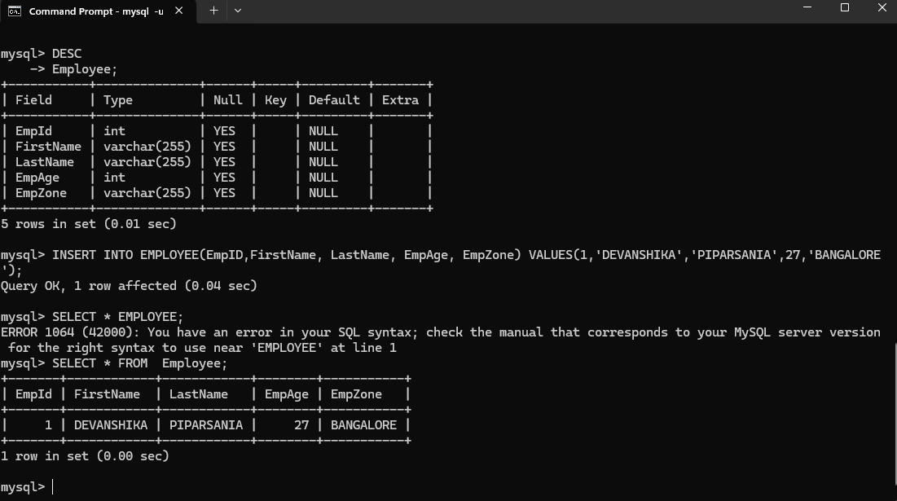
Steps to Insert Records in Table through Command Prompt
Precondition- Follow all the steps till -'Steps to create table through command prompt'
ENTER:
mysql> INSERT INTO EMPLOYEE
(EmpID,
FirstName,
LastName,
EmpAge,
EmpZone)
VALUES(1,
'DEVANSHIKA',
'PIPARSANIA',
27,
'BANGALORE');
Press – Enter
NOTE:BY FOLLOWING SAME STEPS ADD MORE RECORDS

Slide 23
Steps to Insert Records in Table
On database – devanshikadb1 there is a sub-option – Tables and tables have table 'employee', hover the cursor over the 'employee' table, and click on table icon
On table page, you will see two-part, 1st is Querry and second is Result Grid
Querry to get values from a table- SELECT * FROM devanshikadb1.employee;
Result grid is having empty table
Add a value, by double clicking on the grid give value. Example: EmpId=1, EmpName=Devanshika,EmpAge=27,EmpDept=QA
Click on Apply
SQL Script to be applied – INSERT INTO 'devanshikadb1',employee('EmpID',EmpName','EmpAge','EmpDept') VALUES('1','DEVANSHIKA','27','QA');
Click on Apply
Click on Finish
Note: In the same way you can create a new table (Create table for department by following same step)

Slide 24
SELECT statement in MySQL

Slide 25
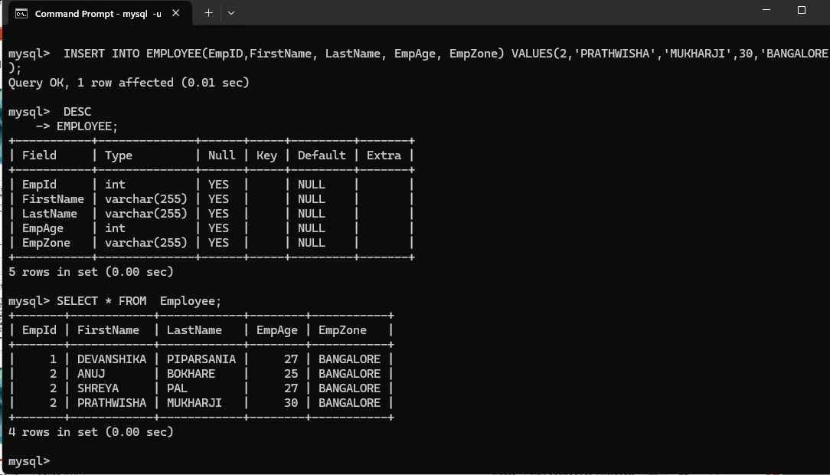
Steps to use SELECT Statement through command prompt
Use select Statement to display all the records from the table – SELECT * FROM EMPLOYEE;

Slide 26
Steps to use SELECT Statement through command prompt
Use select Statement to display SPECIFIC records from the table – SELECT EmpId FROM EMPLOYEE;
SELECT FirstName FROM EMPLOYEE;
SELECT EMPId , FirstName FROM EMPLOYEE;
SELECT EmpZone,FirstName FROM EMPLOYEE;

Slide 27
SQL
CONSTRAINTS

Slide 28
MySQL NOT NULL Constraint

Slide 29
About
Won't have a null value

Slide 30
Steps to set Not Null field in Command Prompt
open Command Prompt
Reached the path where we install MySQL and Copy the path: C:\Program Files\MySQL\MySQL Server 8.0\bin
On command prompt enter – cd and paste the path, press enter
Now, type the command mysql -u root –p
Enter Password, enter
Now, enter command, show databases;, enter
Enter command, USE devabshikadb; , enter
CREATE TABLE MANAGER(
-> ManagerId int NOT NULL,
-> FirstName varchar(255),
-> LastName varchar(255),
-> EmpAge int
-> );
DESC MANAGER;
Enter INSERT INTO MANAGER(ManagerId, FN, LN, EmpAge); VALUES(NULL, 'DEVANSHIKA', 'PIPARSANIA', 27);
Error message should appear – ManagerId cannot be NULL.

Slide 31
MySQL UNIQUE Constraint

Slide 32
About
All the values in a column are unique.
Example: Id

Slide 33
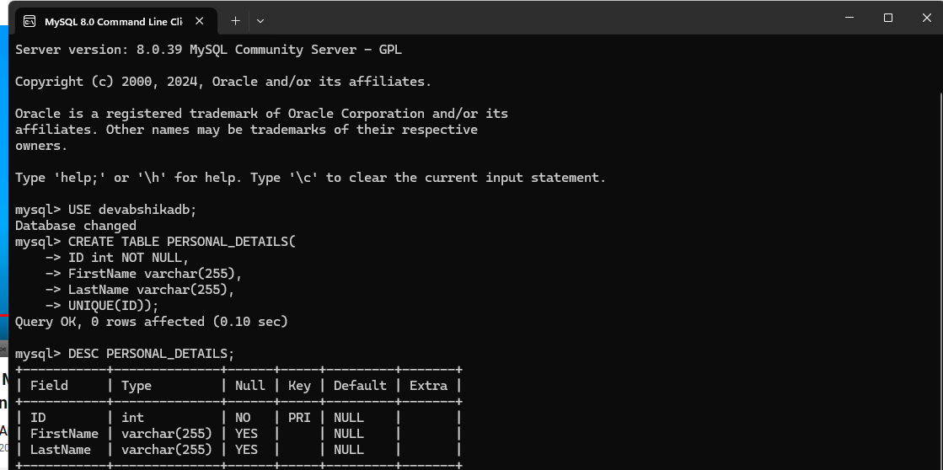
Steps to set UNIQUE Constraint in Command Prompt
Open command prompt
Follow the login steps (aleready mentioned in the previous slides)
Enter - USE devabshikadb;
Hit – Enter
Create a table where in
we will set a field is UNIQUE
and Understand the concept
CREATE TABLE PERSONAL_DETAILS(
-> ID int NOT NULL,
-> FirstName varchar(255),
-> LastName varchar(255),
-> UNIQUE(ID));
Press enter
DESC PERSONAL_DETAILS;
Press Enter

Slide 34
MySQL PRIMARY KEY Constraint

Slide 35
About Primary Key
Uniquely identify each row in a table.
Example: EmpId, Adhaarcard, SSN No., Licence No, Student Roll No, etc

Slide 36
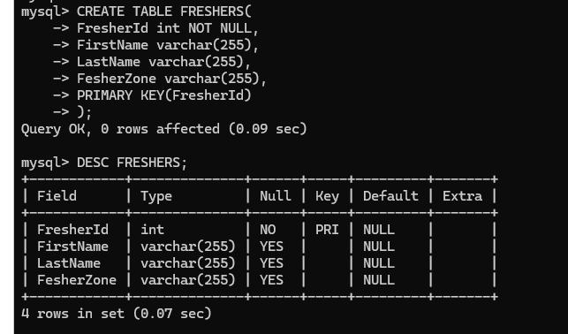
Steps to set field as Primary Key
Open Commad Prompt
Create a table:
mysql> CREATE TABLE FRESHERS(
-> FresherId int NOT NULL,
-> FirstName varchar(255),
-> LastName varchar(255),
-> FesherZone varchar(255),
-> PRIMARY KEY(FresherId)
-> );
Press Enter : Query OK, 0 rows affected (0.09 sec)
mysql> DESC FRESHERS;

Slide 37
MySQL CHECK Constraint

Slide 38
About
All values in a column satisfies a specific conditions.

Slide 39
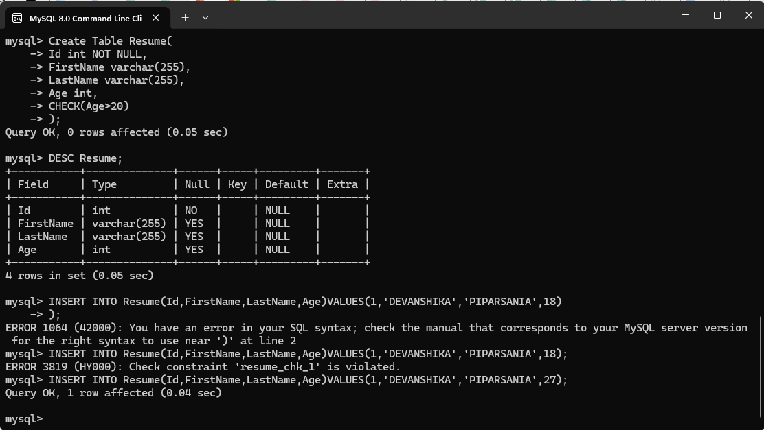
Steps to set Check Constraints in Command Prompt
mysql> Create Table Resume(
-> Id int NOT NULL,
-> FirstName varchar(255),
-> LastName varchar(255),
-> Age int,
-> CHECK(Age>20)
-> );
mysql> DESC Resume;
mysql> INSERT INTO Resume(Id,FirstName,LastName,Age)
->VALUES(1,'DEVANSHIKA','PIPARSANIA',18)
-> );
ERROR 3819 (HY000): Check constraint 'resume_chk_1' is violated.
mysql> INSERT INTO Resume(Id,FirstName,LastName,Age)VALUES(1,'DEVANSHIKA','PIPARSANIA',27);
mysql> SELECT * FROM Resume;

Slide 40
MySQL DEFAULT Constraint

Slide 41
About
Default constraints is used to provide the defaut value for a column
The default value gets added to all the new record, if no other values specified by the user.

Slide 42
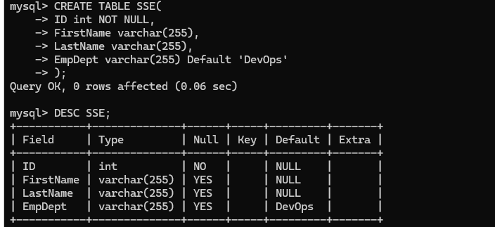
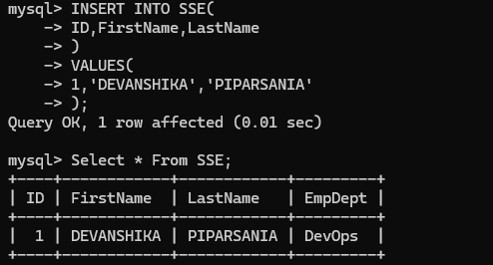
Steps to Add Default Constrains through command Prompt
Enter Command:
mysql> CREATE TABLE SSE(
-> ID int NOT NULL,
-> FirstName varchar(255),
-> LastName varchar(255),
-> EmpDept varchar(255)
->Default 'DevOps'
-> );
Enter Command;
mysql> DESC SSE;
Enter Command
INSERT INTO SSE(
-> ID,FirstName,LastName
-> )
-> VALUES(
-> 1,'DEVANSHIKA','PIPARSANIA'
-> );
mysql> Select * From SSE;

Slide 43
MySQL INDEX Constraint

Slide 44
About
Indexes are basically used to retrive records from the database quickly than any other mathod.

Slide 45
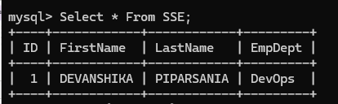


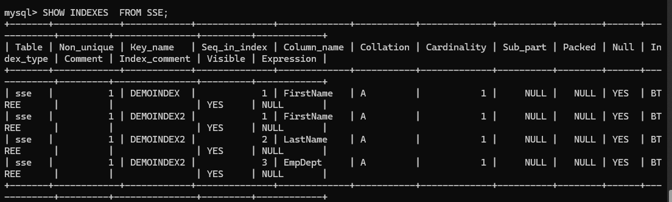
Steps for CREATE Index
Statement 1: Select * From SSE;
Statement 2: CREATE INDEX DEMOINDEX
-> ON SSE(FirstName);
Statement 3: CREATE INDEX DEMOINDEX2
-> ON SSE(
-> FirstName,
-> LastName,
-> EmpDept
-> );
Statement 4: to display indexes
SHOW INDEXES FROM SSE;

Slide 46
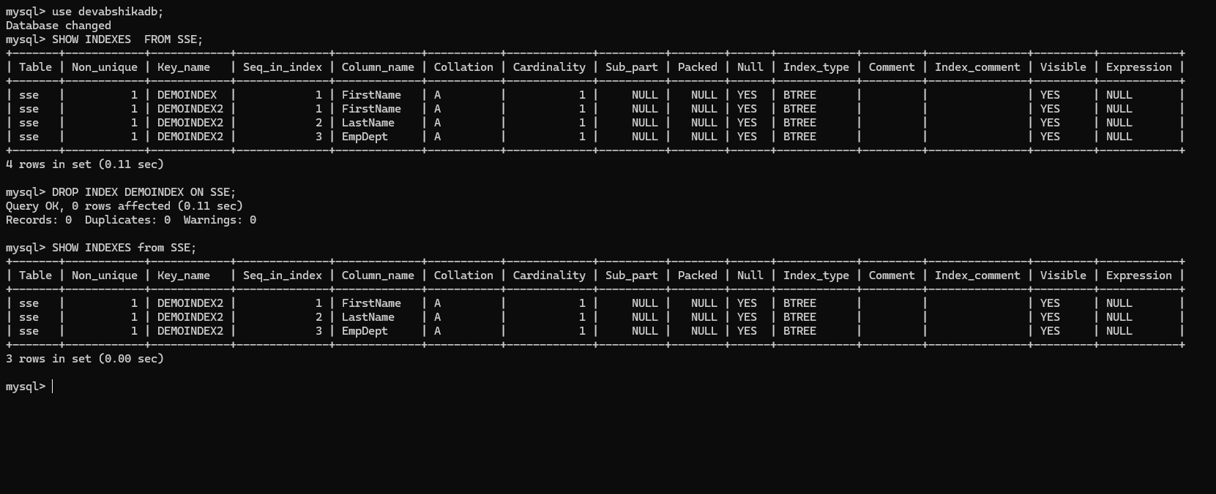
Steps for DROP Index
Statement 1:
use devabshikadb;
Statement 2:
SHOW INDEXES FROM SSE;
Statement 3:
DROP INDEX DEMOINDEX ON SSE;
Statement 4:
to display indexes
SHOW INDEXES from SSE;

Slide 47
MySQL
Alter Table

Slide 48
Alter and Add new Column

Slide 49
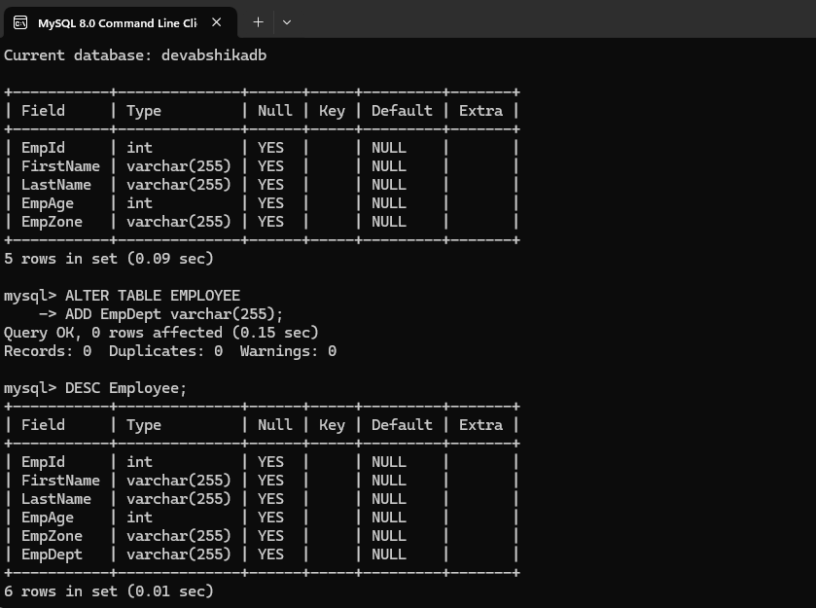
Steps to ADD new Column
Let see the table structure first,
by using this command :
DESC EMPLOYEE;
Press Enter.
Alter and Add Table
by using this Syntax:
ALTER TABLE EMPLOYEE
-> ADD EmpDept varchar(255);
Press Enter
Enter: DESC EMPLOYEE;
Press: Enter

Slide 50
Alter and DROP Column

Slide 51
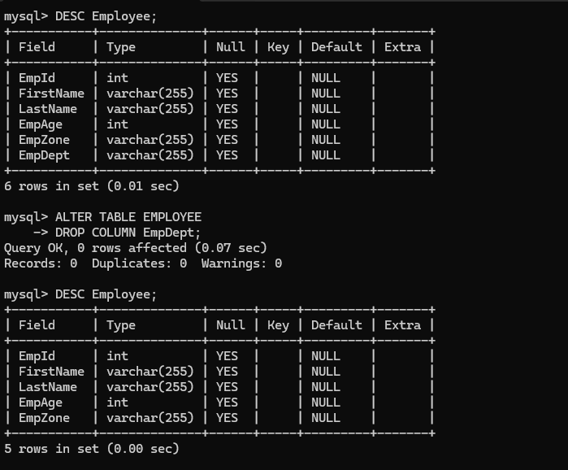
Steps to DROP Column
Let see the table structure first,
by using this command :
DESC EMPLOYEE;
Press Enter.
Alter and Drop column
by using this Syntax:
ALTER TABLE EMPLOYEE
-> DROP COLUMN EmpDept;
Press Enter
Enter: DESC EMPLOYEE;
Press: Enter

Slide 52
Alter TABLE and MODIFY Column

Slide 53
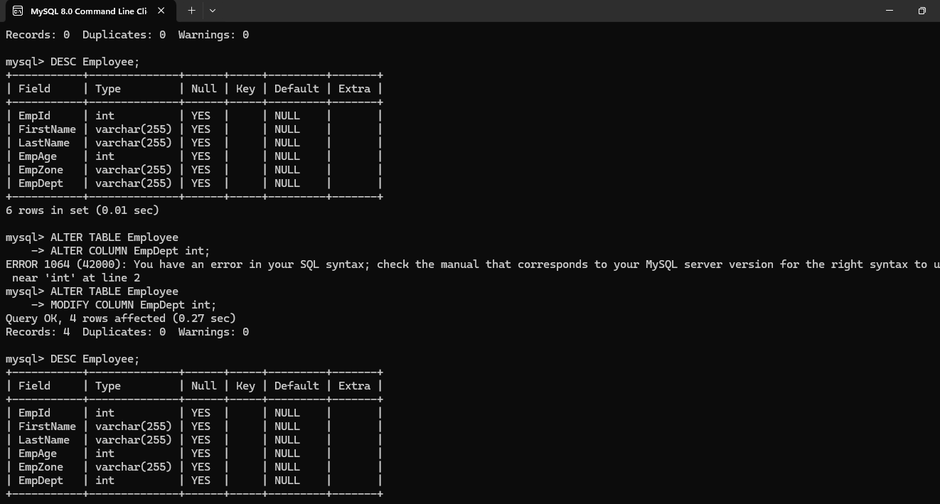
Steps to MODIFY Column
Let see the table structure first,
by using this command :
DESC EMPLOYEE;
Press Enter.
Alter and Drop column
by using this Syntax:
ALTER TABLE EMPLOYEE
-> MODIFY COLUMN EmpDept INT;
Press Enter
Enter: DESC EMPLOYEE;
Press: Enter

Slide 54
MySQL
SELECT DISTINCT in mysql

Slide 55
About Distinct
Different Values which are not Duplicate

Slide 56
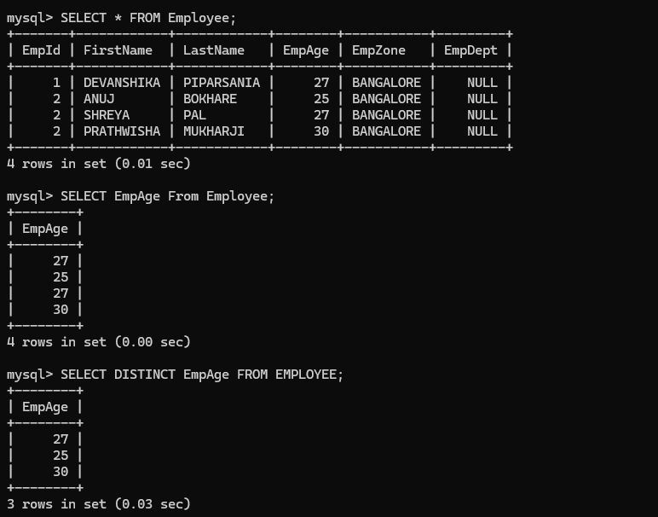
Steps to Select Distinct
Fisrt check the Table Record :
by using this Statement
SELECT * FROM EMPLOYEE;
Press Enter.
Select Distinct:
By Using this statement
SELECT EmpAge From Employee;
mysql> SELECT DISTINCT EmpAge FROM EMPLOYEE;
Press Enter

Slide 57
MySQL
DISPLAY RECORDS FROM SPECIFIC COLUMNS

Slide 58
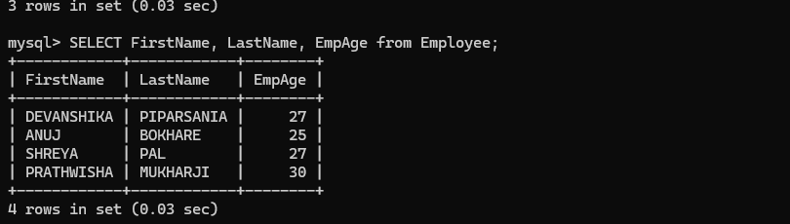
STEPS to DISPLAY RECORDS FROM SPECIFIC COLUMN
Enter Command :
SELECT FirstName, LastName,EmpAge FROM Employee;

Slide 59
MySQL
CLAUSe

Slide 60
WHERE Clause

Slide 61
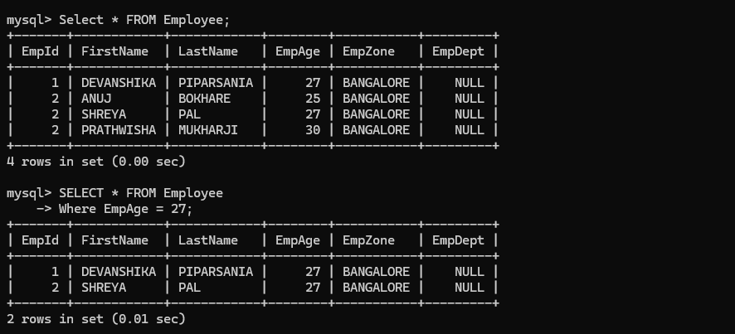
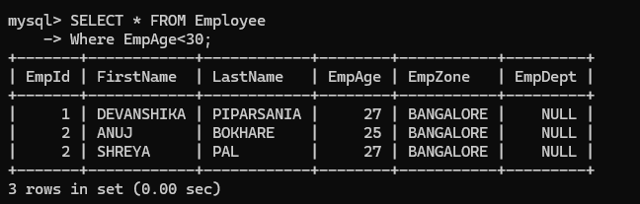
Steps to use Where Clause
Enter : mysql> Select * FROM Employee;
Press: Enter
Enter :
mysql> SELECT * FROM Employee
-> Where EmpAge = 27;
mysql> SELECT * FROM Employee
-> Where EmpAge<30;

Slide 62
LIMIT Clause

Slide 63
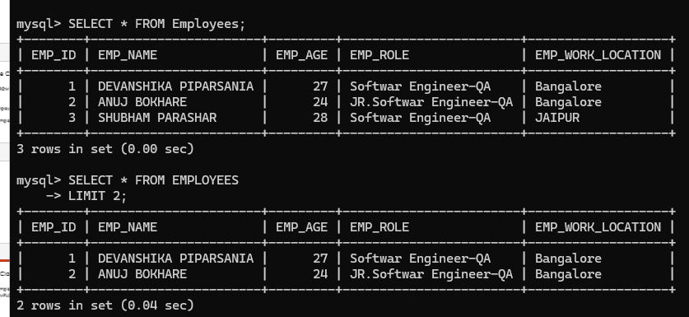
Steps to use LIMIT Clause
mysql> SELECT * FROM Employees;
mysql> SELECT * FROM EMPLOYEES
-> LIMIT 2;

Slide 64
MySQL
OPERATOR

Slide 65
AND Operator

Slide 66
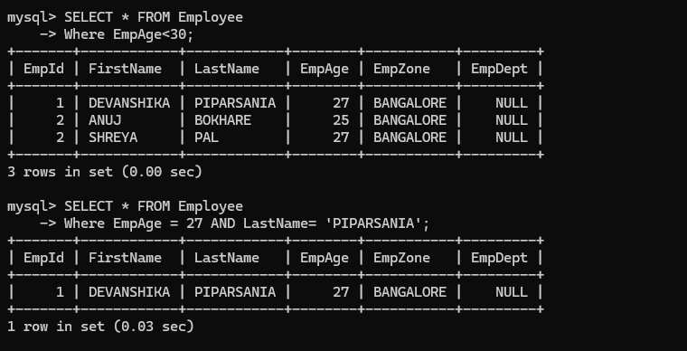
Steps to Use AND Operator
mysql> SELECT * FROM Employee
-> Where EmpAge = 27 AND LastName= 'PIPARSANIA';

Slide 67
OR Operator

Slide 68
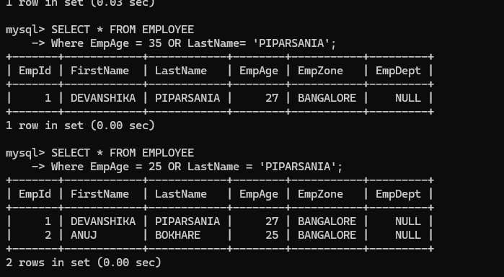
Steps to Use OR Operator
If one Conditon satisfy
mysql> SELECT * FROM EMPLOYEE
-> Where EmpAge = 35
OR
LastName= 'PIPARSANIA';
If both Condition satisfy
SELECT * FROM EMPLOYEE
-> Where EmpAge = 25
OR
LastName = 'PIPARSANIA';

Slide 69
NOT Operator

Slide 70
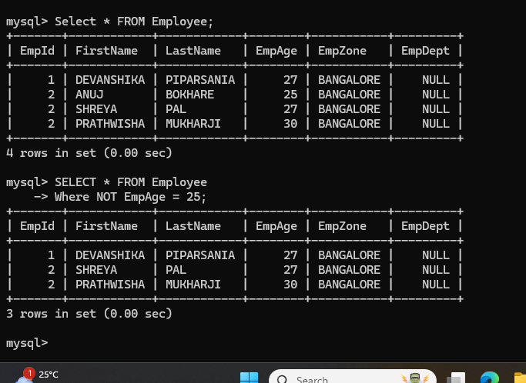
Steps to Use NOT Operator
Imysql> SELECT * FROM EMPLOYEE Where NOT EmpAge = 25;

Slide 71
IN Operator

Slide 72
About In Operator
The IN operator in MySQL is used to specify multiple values in a WHERE clause. It is a shorthand for multiple OR conditions. This operator is particularly useful when you want to filter records based on a list of values.

Slide 73
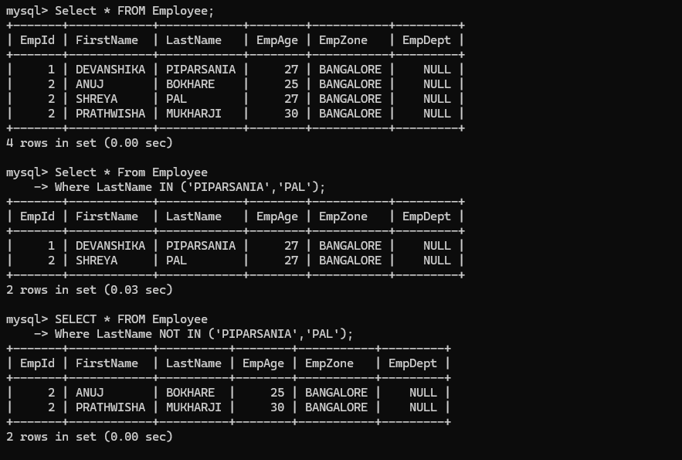
STEPS TO USE IN Operator
mysql> Select * FROM Employee;
mysql> Select * From Employee
-> Where LastName
-> IN ('PIPARSANIA','PAL');
mysql> SELECT * FROM Employee
-> Where LastName
-> NOT IN ('PIPARSANIA','PAL');

Slide 74
LIKE Operator

Slide 75
About Like Operator
The LIKE operator in MySQL is used to search for a specified pattern in a column. It’s particularly useful for finding records that match specific criteria, such as names starting with a certain letter or containing a specific word.

Slide 76
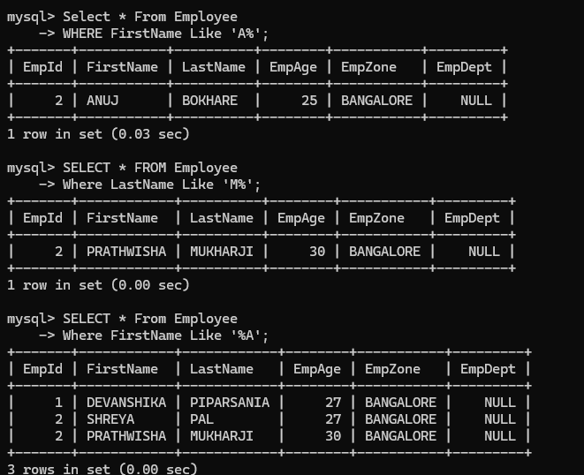
How to Use LIKE Operator
mysql> Select * From Employee
-> WHERE FirstName Like 'A%';
mysql> SELECT * FROM Employee
-> Where LastName Like 'M%';
mysql> SELECT * From Employee
-> Where FirstName Like '%A';

Slide 77
BETWEEN Operator

Slide 78
ABOUT BETWEEN OPERATOR
The BETWEEN operator in MySQL is used to filter the results of a query to include only those records where a specific column’s values fall within a given range. This operator is inclusive, meaning it includes the boundary values specified.

Slide 79
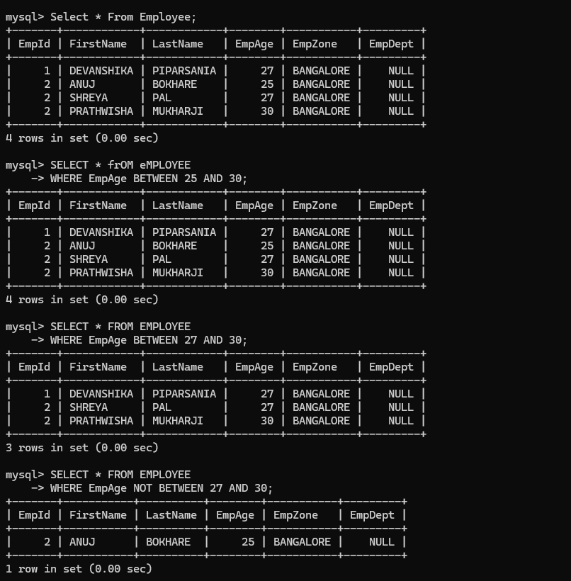
Steps to Use BETWEEN Operator
mysql> Select * From Employee;
mysql> SELECT *
FROM EMPLOYEE
-> WHERE EmpAge
BETWEEN 27 AND 30;
mysql> SELECT *
FROM EMPLOYEE
-> WHERE EmpAge
NOT BETWEEN 27 AND 30;

Slide 80
MySQL
COMMENTS

Slide 81
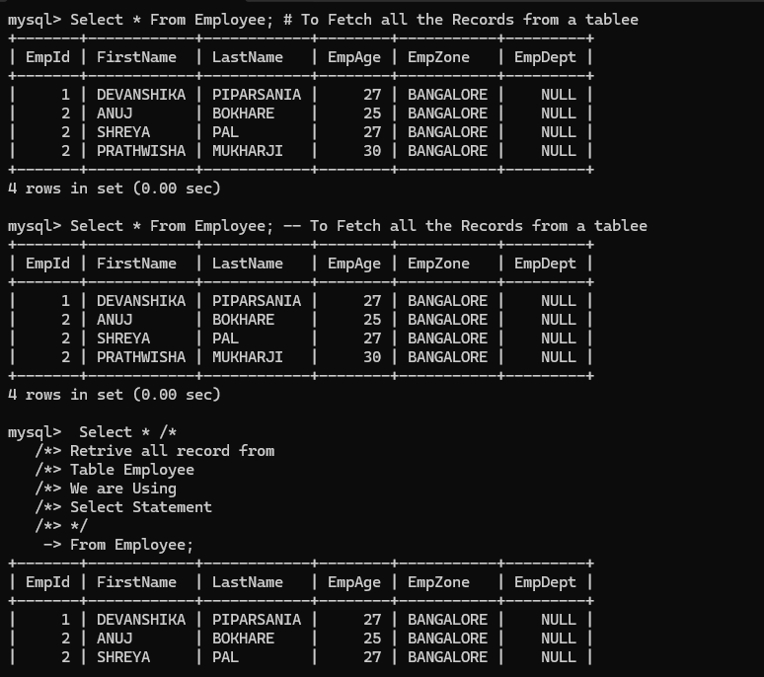
How to add Comments in My Sql
#,--, /* */

Slide 82
MySQL
Methods

Slide 83
MySQL COUNT() method

Slide 84
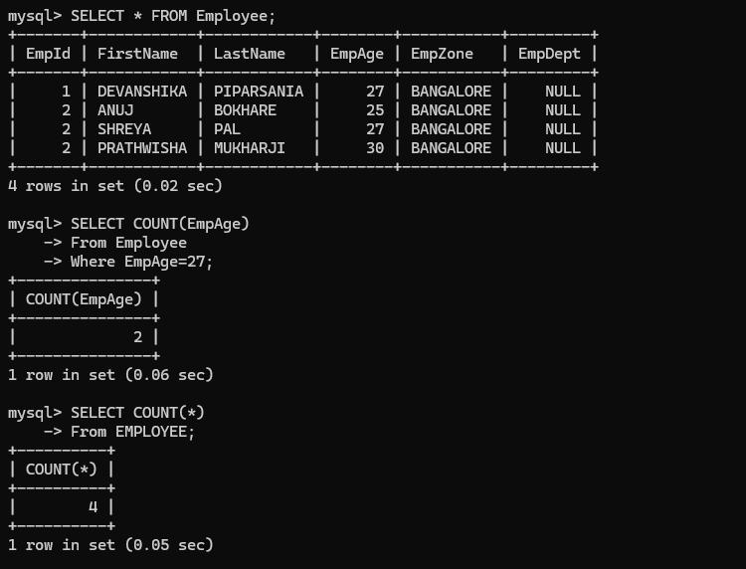
Steps to use COUNT()
mysql> SELECT * FROM Employee;
For count specific:
mysql> SELECT COUNT(EmpAge)
-> From Employee
-> Where EmpAge=27;
For Count all:
mysql> SELECT COUNT(*)
-> From EMPLOYEE;

Slide 85
MySQL
ALIAS in My SQL

Slide 86
About Alias
In Database term, alias is a temporary name i.e., given to a table or column while showing the results. So, the alias is good for makes the column more readable and it only exist for the duration of the query, that means after that when you will see the output and will execute the new query the previous temporary name given to a column will get vanished

Slide 87
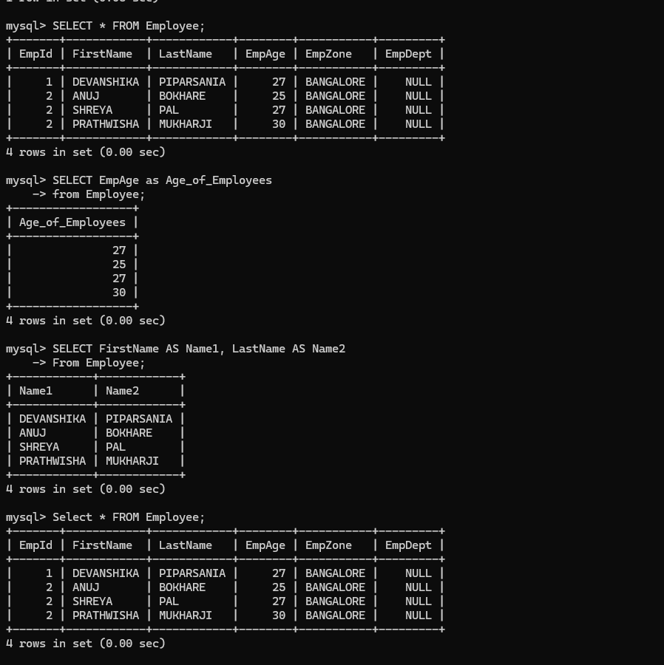
How to use Alias
mysql> SELECT * FROM Employee;
Let say we need to retrive
only the Age Column from
the employee table and
the heading should not be
"EmpAge", So we can
achive this using Alias
mysql> SELECT EmpAge
as Age_of_Employees
-> from Employee;
mysql> SELECT FirstName AS Name1,
LastName AS Name2
-> From Employee;
mysql> SELECT * FROM Employee;

Slide 88
MySQL
STATEMENTS

Slide 89
CASE Statement

Slide 90
About Case Statement
Case Statement goes through conditions, and it will return a value if the first condition is met.
Works just like, if, then else statement. So, If condition is not met then else condition value will get displayed

Slide 91
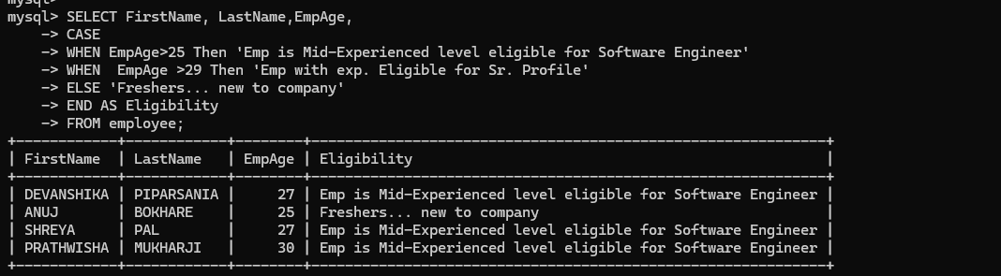
How to use Case Statement
SELECT FirstName, LastName,EmpAge,
-> CASE
-> WHEN EmpAge>25
Then 'Emp is Mid-Experienced
level eligible for Software Engineer'
-> WHEN EmpAge >29
Then 'Emp with exp.
Eligible for Sr. Profile'
-> ELSE 'Freshers...
new to company'
-> END AS Eligibility
-> FROM employee;

Slide 92
DELETE Statement

Slide 93
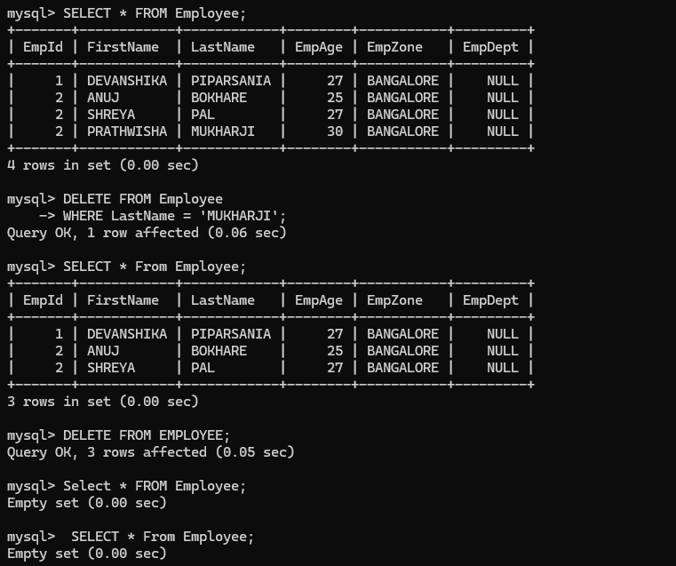
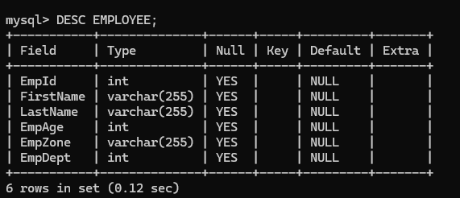
How to Use DELETE Statement
mysql> SELECT *
FROM Employee;
mysql> DELETE FROM
Employee
-> WHERE
LastName = 'MUKHARJI';
SELECT * From Employee;
DELETE FROM EMPLOYEE;
mysql> Select *
FROM Employee;
mysql> DESC EMPLOYEE;

Slide 94
UPDATE Statement

Slide 95
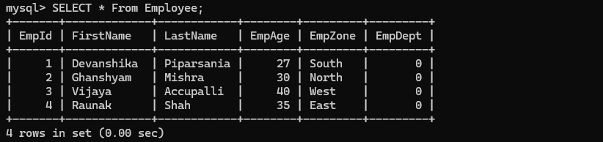
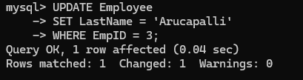
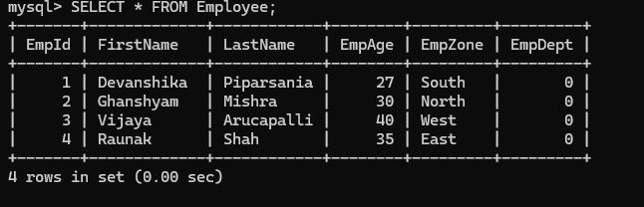
How to use UPDATE Statement
mysql> SELECT * From Employee;
Update Last Name:
mysql> UPDATE Employee
-> SET LastName = 'Arucapalli'
-> WHERE EmpID = 3;
mysql> SELECT * FROM Employee;

Slide 96
MySQL
DROP

Slide 97
DROP TABLE

Slide 98
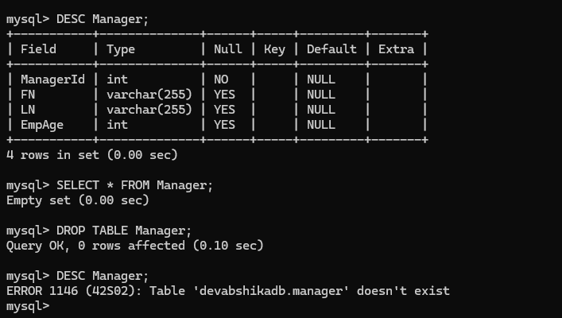
How to Drop a table
mysql> DESC Manager;
mysql> SELECT * FROM Manager;
mysql> DROP TABLE Manager;
mysql> DESC Manager;

Slide 99
DROP DATABASE

Slide 100
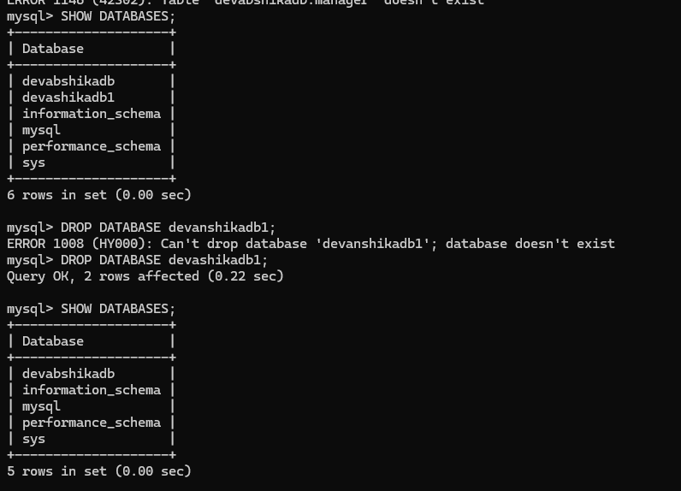

How to Drop Database
mysql> SHOW DATABASES;
mysql> DROP DATABASE devashikadb1;
mysql> SHOW DATABASES;
mysql> use devashikadb1;

Slide 101
MySQL
Methods

Slide 102
MySQL AVG() Method

Slide 103
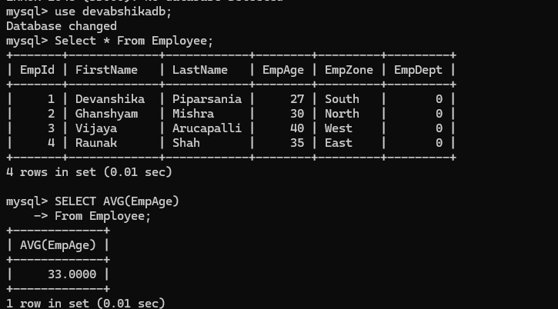
Steps to use AVG() Method
mysql> use devabshikadb;
mysql> Select * From Employee;
mysql> SELECT AVG(EmpAge)
-> From Employee;

Slide 104
MySQL SUM() Method

Slide 105
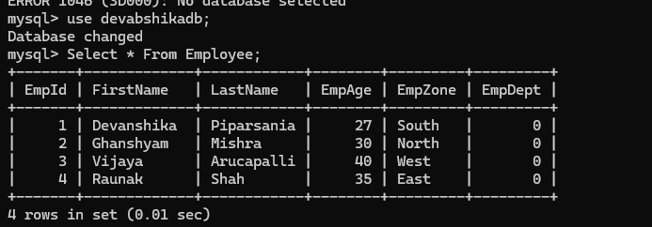
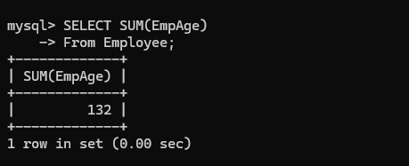
Steps to use SUM() Method
mysql> use devabshikadb;
mysql> Select * From Employee;
mysql> SELECT SUM(EmpAge)
-> From Employee;

Slide 106
MySQL MAX() Method

Slide 107
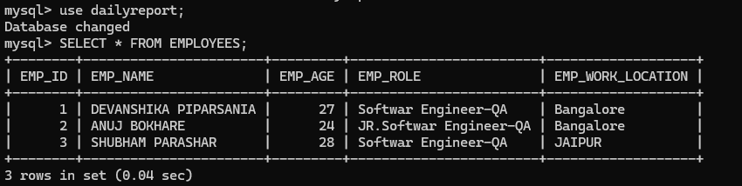
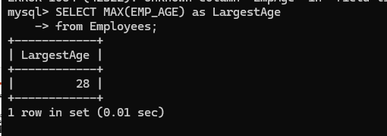
How to use MAX() Method/Function
mysql> use dailyreport;
mysql> SELECT * FROM EMPLOYEES;
mysql> SELECT MAX(EMP_AGE) as LargestAge
-> from Employees;

Slide 108
MySQL MIN() Method

Slide 109
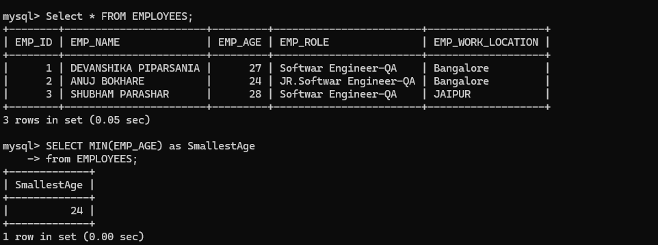
How to use MAX() Method/Function
mysql> use dailyreport;
mysql> SELECT * FROM EMPLOYEES;
mysql> SELECT MIN(EMP_AGE) as SmallestAge
-> from Employees;

Slide 110
MySQL
Order

Slide 111
Order By Keyword Ascending Order

Slide 112
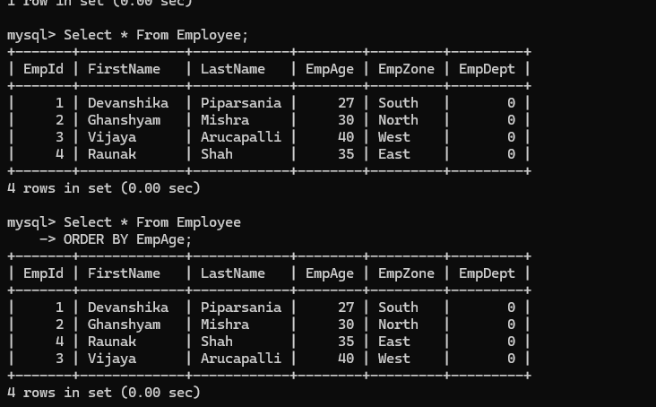
How to show data in accending order
Note: By Default data show in the Accending order
Short the data by age in Ascending order
mysql> Select * From Employee
-> ORDER BY EmpAge;

Slide 113
Order By Keyword Decending Order

Slide 114
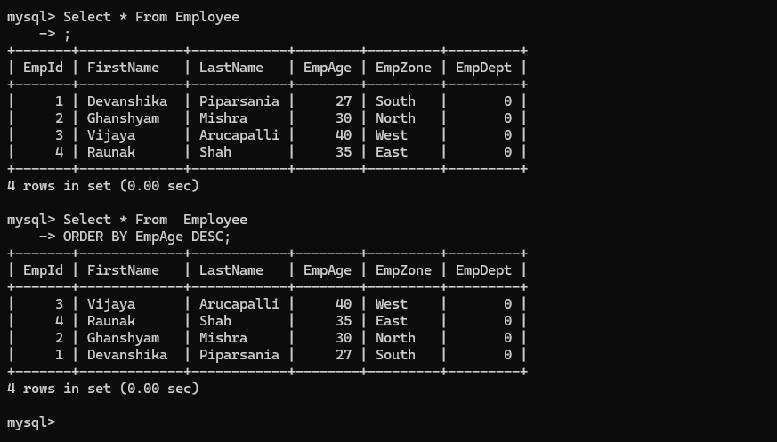
How to show data in descending order
Short the data by age in descending order
Select * From Employee
-> ORDER BY EmpAge DESC;

Slide 115
MySQL
Auto Increment

Slide 116
About Auto Increment
Auto Increment Allows you to add a unique number which gets generated automatically on inserting a new record in the table
Lets say you set a field as Auto Increment - >
It will give a Unique Number(Generally 1,2,3,4.. Will get generated )
And whenever you insert new record it will increment one by one. It is often a primary key that get craeted and incremented automatically whenever a new record is inserted

Slide 117
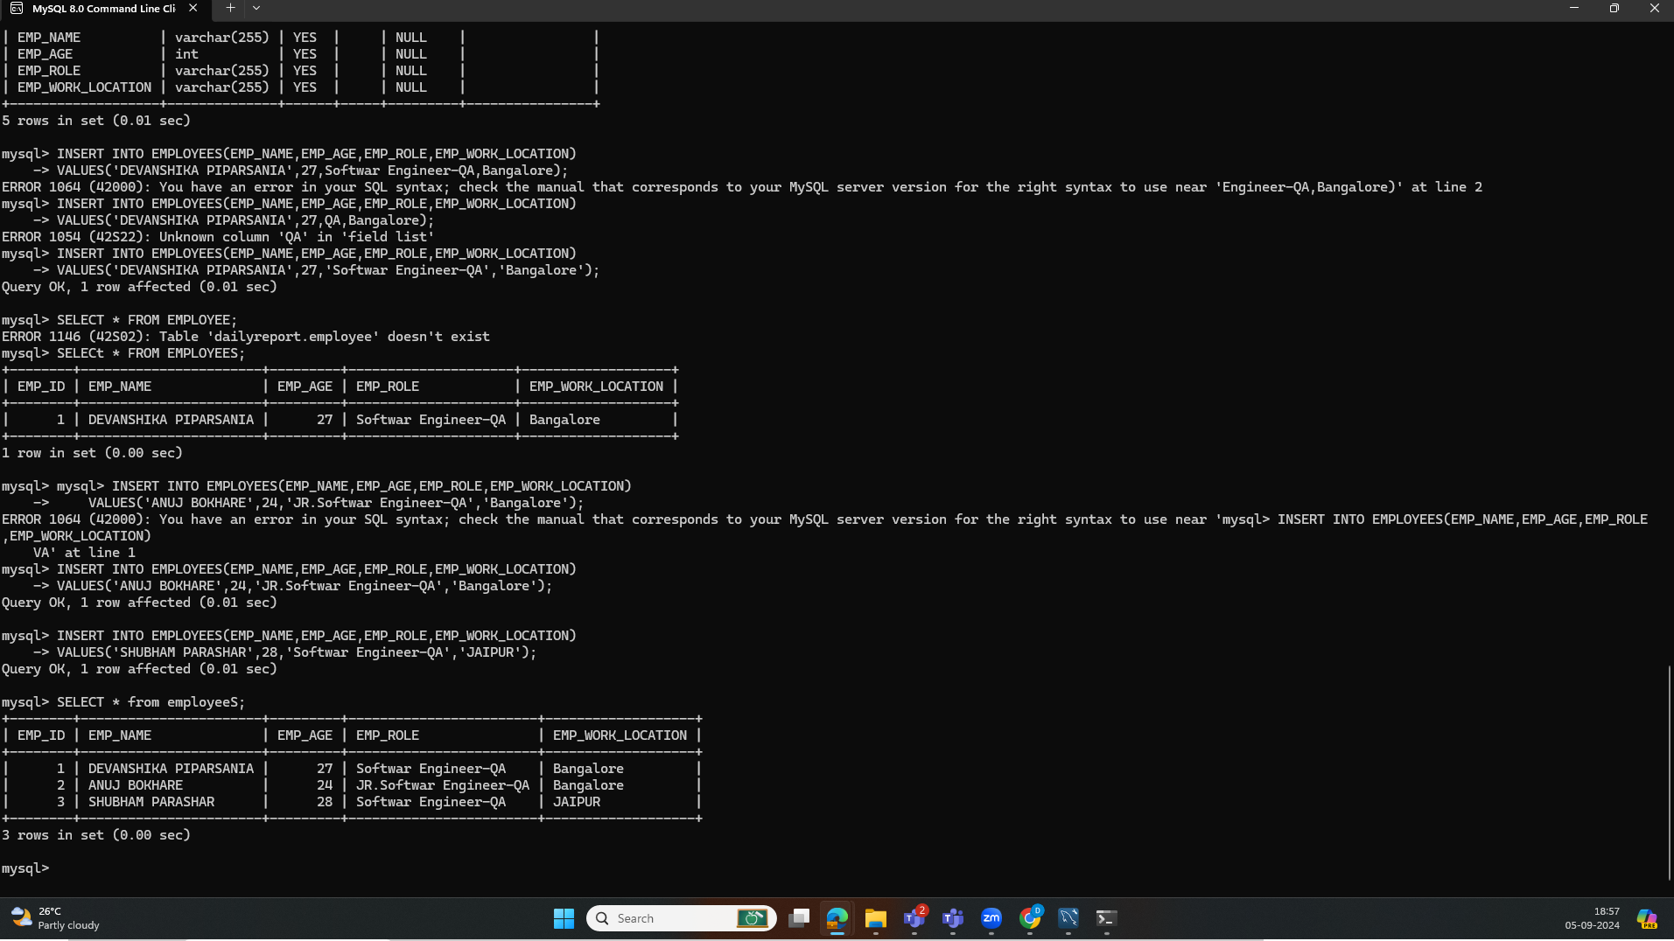
How to use Auto Increment
mysql> CREATE DATABASE DailyReport;
mysql> SHOW DATABASES;
mysql> use dailyreport;
mysql> CREATE TABLE EMPLOYEES(
-> EMP_ID int NOT NULL AUTO_INCREMENT,
-> EMP_NAME varchar(255),
-> EMP_AGE int,
-> EMP_ROLE varchar(255),
-> EMP_WORK_LOCATION varchar(255),
-> PRIMARY KEY(EMP_ID)
-> );
mysql> DESC EMPLOYEES;
INSERT INTO EMPLOYEES(EMP_NAME,EMP_AGE,EMP_ROLE,EMP_WORK_LOCATION)
-> VALUES('DEVANSHIKA PIPARSANIA',27,'Softwar Engineer-QA','Bangalore');

Slide 118
MySQL
JOINS

Slide 119
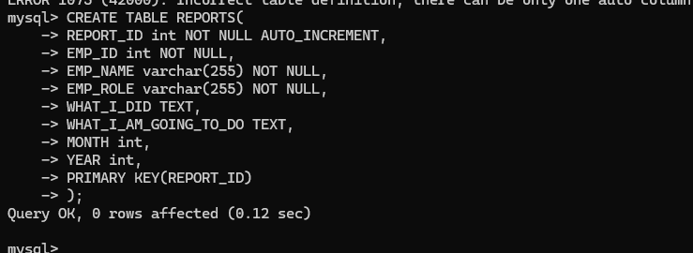
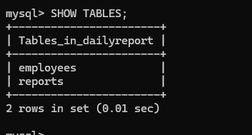
PRECONDITONS
DATABASE SHOULD HAVE ATLEAST 2 TABLES
AS WE HAVE DATABASE WITH NAME – DAILYREPORT
AND TABLE – EMPLOYEES
CREATE ANOTHER TABLE REPORTS
mysql> CREATE TABLE REPORTS(
-> REPORT_ID int NOT NULL AUTO_INCREMENT,
-> EMP_ID int NOT NULL,
-> EMP_NAME varchar(255) NOT NULL,
-> EMP_ROLE varchar(255) NOT NULL,
-> WHAT_I_DID TEXT,
-> WHAT_I_AM_GOING_TO_DO TEXT,
-> MONTH int,
-> YEAR int,
-> PRIMARY KEY(REPORT_ID)
-> );

Slide 120
INNER JOINS

Slide 121
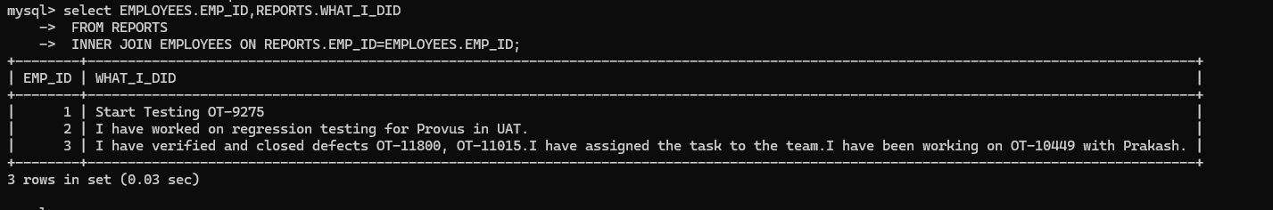
Steps to use inner joins
mysql> select EMPLOYEES.EMP_ID,REPORTS.WHAT_I_DID
-> FROM REPORTS
-> INNER JOIN EMPLOYEES ON REPORTS.EMP_ID=EMPLOYEES.EMP_ID;

Slide 122
LEFT JOIN

Slide 123
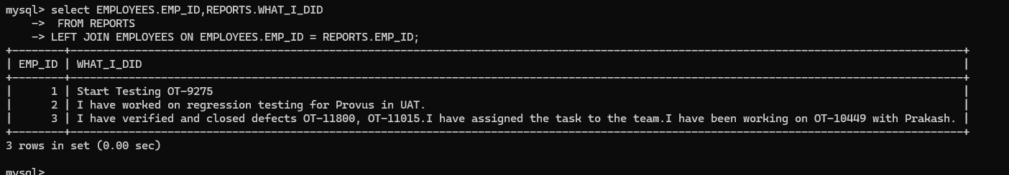
STEPS to use LEFT JOINS
mysql> select EMPLOYEES.EMP_ID,REPORTS.WHAT_I_DID
-> FROM REPORTS
-> LEFT JOIN EMPLOYEES ON EMPLOYEES.EMP_ID = REPORTS.EMP_ID;

Slide 124
RIGHT JOIN

Slide 125
FULL JOIN (NOT SUPPORTED IN MYSQL)

